Slide 1

DaDetective
DaGamers
Team Members:
Tan Weijian Colin – Producer + Asset + QA
Koh Meng Hui – Knowledge Map + AI
Tan Zhen Yang – AI
Low Xu Yan Jessica – Level + GUI
Alicia Lee Jiayi – AI

Slide 2
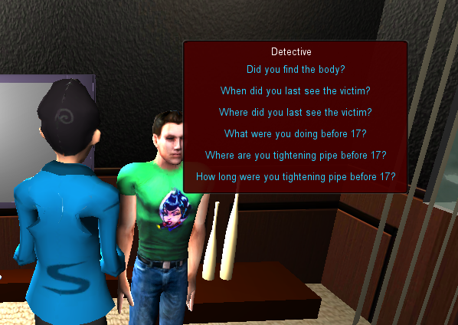
the game
Single-player murder
mystery solving
Story: Someone is murdered inside a room, by one of his 4 family members
Goal: Find the murderer, time of crime, and weapon by asking suspects questions

Slide 3
the technical challenge
Premise: Clues (answers) randomly generated
Each time game runs:
  Generates the story for 3 time periods: BeforeMurder, DuringMurder and AfterMurder
  Generate a murderer X from Suspects, his activity, fake activity, and alibi
  Fills up the rest of the Suspects with activites

Slide 4
achievements / difficulties
+ Managed to come out with a Constrains-Satisfaction rule-based algorithm
- Debugging C# within and outside Unity
- Difficult to understand and use one another’s code

Slide 5
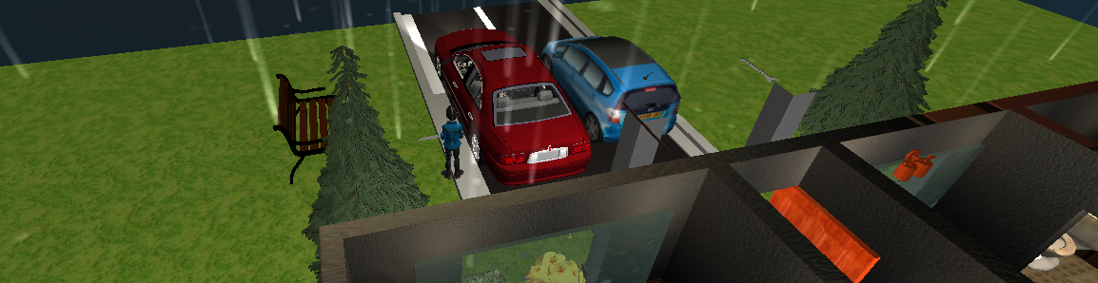
what prototype proves
Every run of the game generates a new mystery story
Increases re-playability and difficulty
Able to traverse the Question-Answer Tree when detective ask the correct question

Slide 6
future plans
Include 3 difficulty levels
Heuristics: add heuristics and cost functions to the tree
Progress checker
Improve the camera using ray-casting
Simple testing to determine difficulty is anticipated and tweaked correctly

Slide 7


